Slide 1
Java Arrays

Slide 2

Today’s agenda
Describe one of Java’s fundamental container types; the array.
Demonstrate how to create, populate, and access values from an array.
Show the most common pitfall when working with containers.

Slide 3
Basic container type
Arrays – Indexed-based collection type

Slide 4
Why do we need collection types?
You are a teacher and you have written a Java application to help you keep track of student attendance.
The number of students attending your class each week is recorded in your Java app as an int variable.
int weekOne = 54;
int weekTwo = 49;
int weekThree = 29; // Flu season
At the end of term, how do you add these figures together easily, how do you sort them?
int total = weekOne + weekTwo + weekThree // etc.
One possible way of simplifying this is to use arrays.

Slide 5
Variables vs. Arrays
Individual variables
Alternative (arrays)
Each individual variable needs to be declared (and given a name).
Declare once and number each location.
Memory |  | Java
 | :
weekOne | 54 | int weekOne = 54;
weekTwo | 49 | int weekTwo = 49;
weekThree | 29 | int weekThree = 29;
 | :
Memory |  | Java
 | : | int[] att = new int[12];
att 0 | 54 | att[0] = 54;
1 | 49 | att[1] = 49;
2 | 29 | att[2] = 29;
 | :
Total Algorithm
total = weekOne + weekTwo + weekThree
Total Algorithm
total = 0
for i = 0 to last week number
total = total + att element i

Slide 6
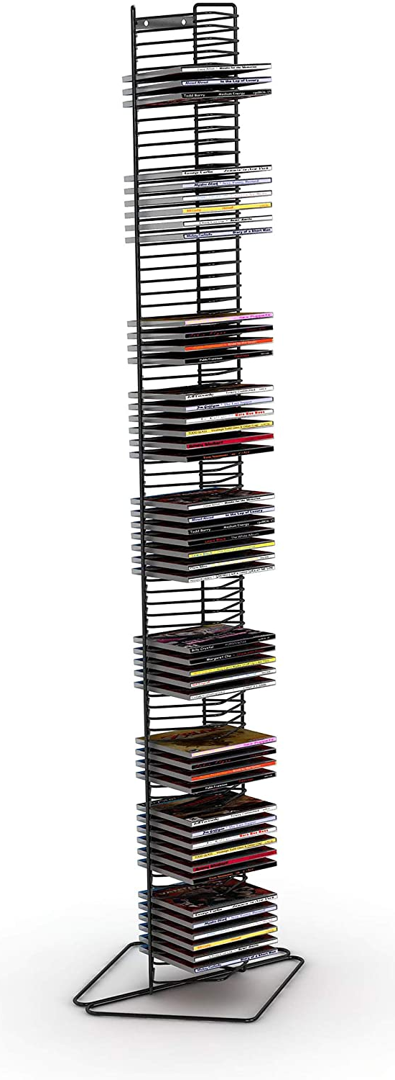
An array metaphor - the CD rack
Arrays
Are containers for closely related variables and objects.
Think of a CD stacking unit (with individual trays for each CD).
Arrays contain a group of data items (known as elements).
All elements must be of the same type (e.g. int, char, boolean, String etc… but also objects)
Once you set the size of an array, it cannot be changed.
Array is a Java class.

Slide 7
Creating an array
Follow these stages when creating arrays.
Declare an instance of the Array class using special syntax.
int[] attendanceData = new int[12];
Fill the ‘slots’ of the array with data.
This is sometimes called ‘populating’ the array.
attendanceData[0] = 54;
attendanceData[1] = 49;
attendanceData[2] = 29;

Slide 8
Declaring an array
int[] attendanceData = new int[12];
identifier of the array (a reference variable)
Number of elements that will be stored in the array
Type of data to be stored in the array
Call to the constructor
Square brackets indicate we are declaring an array
Link the reference variable to the array object

Slide 9
Storing values into array elements
attendanceData[0] = 54;
attendanceData[1] = 49;
attendanceData[2] = 29;
New value to be stored at this index position. Can be a value, a variable or a reference variable.
Identifier of array we wish to add element to.
Number corresponding to the index position of the array where we want the element to be stored.
index | value
0 | 54
1 | 49
2 | 29

Slide 10
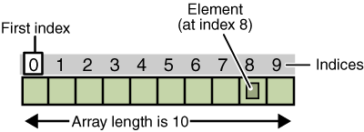
Array indexing
If it helps, think of array slots as car parking bays, and elements as cars.

Slide 11
Using array elements in your code
Use elements of the array exactly as you would use a normal variable or object. Format arrayName[elementNumber]
System.out.println(attendanceData[0]);
int a = attendanceData[0] + 4;
if (attendance[2] > 50) { }
You can print elements to console
You can use elements in assignments
You can use elements in logical tests

Slide 12
Array data types
In the previous examples, we created an array of integers.
Other arrays using primitive variables:
char[] grades = new char[62];
double[] dailyTemps = new double[100];
boolean[] examAnswers = new boolean[20];

Slide 13
Quick exercise
Write the Java code to:
Declare an array of String[] called week to record the day names of the week.
Populate the array.
Print your favourite day to console in the format:
"My favourite day is X"

Slide 14
Quick exercise solution
String[] week = new String[7];
week[0] = "Monday";
week[1] = "Tuesday";
// continues
week[6] = "Sunday";
System.out.print("My favourite day is " + week[5]);

Slide 15
Array initialisation
When you know the data in advance, we can use the following syntax to assign the initial values :
String[] week = {"Monday", "Tuesday",
"Wednesday", "Thursday", "Friday",
"Saturday", "Sunday" };
System.out.print("My favourite day is " + week[5]);

Slide 16
Printing all array elements
To print the days of the week in order – do we have to use this approach?
System.out.println(week[0]);
System.out.println(week[1]);
System.out.println(week[2]);
No, this would be inefficient and unnecessary.
We can just iterate through the array of Strings using a looping statement.
Arrays combined with looping statements are very powerful.

Slide 17
Iteration and printing
Using a loop to iterate through the array and printing:
// Assumes array has been declared and populated
for (int i = 0; i < 7; i++)
{
System.out.println(week[i]);
} // end of for loop

Slide 18
Array out of bounds exception
The most common error when using an array with a loop is the ArrayIndexOutOfBoundsException (OOB).
It happens when a loop iterates too many times and you try to retrieve an element outside of the range of the array.
For example, imagine the array has 7 elements and you try to get element 8.
An out of bounds exception is a run-time error as opposed to a compilation error.

Slide 19
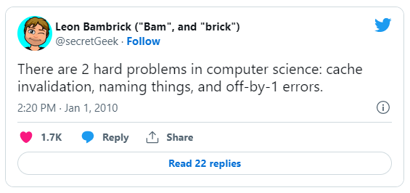
Programmer joke alert …
https://martinfowler.com/bliki/TwoHardThings.html

Slide 20
Array OOB exception example
This code will generate an OOB exception.
// Assumes array has been declared and populated
for (int i = 0; i <= 7; i++)
{
System.out.println(week[i]);
} // end of for loop
On the last iteration of this loop, this code will try to print the 8th element of the week array (i.e. week[7]) which does not exist!

Slide 21
What happens here?
What will happen when I compile and run this code?
// Assumes array has been declared and populated
for (int i = 0; i < 7; i++)
{
System.out.println("Today is " + week[i]);
System.out.println("Tomorrow is " + week[i+1]);
} // end of for loop

Slide 22
Array length variable
A common technique for avoiding OOB exceptions uses the length field of the Array class.
The length variable is part of the state of an Array object.
You can access this variable in the following way:
week.length
Use this variable to error proof your looping statements.

Slide 23
Example using array length
Or will it?!
This code will not generate an OOB exception.
// Assumes array has been declared and populated
for (int i = 0; i <= week.length; i++)
{
System.out.println(week[i]);
} // end of for loop

Slide 24
Avoiding OOB: the enhanced for-loop
The enhanced for statement iterates through the elements of an array without using a counter, thus avoiding the possibility of “stepping outside” the array.
for (parameter : arrayName) {
// statements
}
parameter has a type and an identifier (e.g. int number).
arrayName is the array through which to iterate.
The type of the parameter must be consistent with the type of the elements in the array.

Slide 25
Enhanced for-loop example
String[] week = { "Sunday", "Monday", "Tuesday",
"Wednesday", "Thursday", "Friday",
"Saturday", "Sunday" };
// equivalent to foreach element in array
// prevents out of bound errors, but doesn’t
// give you an index to make use of in loop
for (String s : week) {
System.out.println(s);
} // end of for loop

Slide 26
Let’s consider a problem …
Given an array of <insert type here> and of any length how would you reverse its contents?
3
2
-9
88
4
2
0
-1
Let’s consider a possible Java solution!

Slide 27
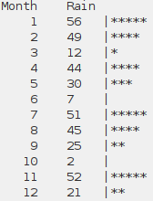
Let’s consider another problem …
Write a program that collects and processes monthly rainfall data. We'll collect the data from the user, and then display a sideways Histogram.
Let’s consider a possible Java solution!

